Slide 1

Let’s Meet
Group Id: 05
Jaishil Bhavsar (3005)
Zeel Modi (3036)
Bhargavi Jansari (3186)
Submitted to:
K. S. School of Business Management
M. Sc. – Computer Applications and Information Technology

Slide 2
Company Profile
Organization Name: Dhruv Corporation.
Address: 23, RadhaKrishna Avenue, Opp. Golden Triangle, Stadium Road, Navrangpura, Ahmedabad-18, Gujarat, India.
Contact No.: 9428106009
Name and the Designation of Chief Functionary: Mr. Arvind Modi (Owner)
About Organisation:
Dhruv Corporation is a Fabric Trading Company which provides different types of fabric. The Company’s owner is Mr. Arvind Modi. He has been running from last 3 years. It has started from 2014. It has started from a little cabin to a big castle. First shop of Dhruv Corporation was in Ahmedabad where the company got all customers.
The company is having a block printers, embroidering artist and even a Kalamkari artist which provides all types of varieties on Fabrics. Company is getting its growth. They are taking customer orders and they also organise Fashion shows every year to advertise and market their different products.
They are serving their Fabric to most of all boutique in Ahmedabad and even out of town. Company is organising a little concept about gathering people and connect them. Company has planned to create events which are on one platform. It is organised around one simple idea “When we get together and do the things that matter to us we are at our best!” Their motto is the connecting bridge between user who are looking for events and event promoters who are in search of their audience.

Slide 3
Table of Contents
Existing System
Proposed System
Scope of System
Objectives of System
Stakeholders of System
Project Definition
Feasibility Study
Hardware – Software Requirements
Gantt Chart and Work Breakdown Structure – Diagram
UML Diagram
System Flow Diagram
Data Dictionary
User Interface
System Navigation Diagram
Limitations
Future Scope
Bibliography

Slide 4
Existing System
There is no Current System. The system is working manually. The current system is time consuming because it involves a lot of paperwork and efforts.
In manual system they are calling people and informing them about the event that is about to happen. Sometimes while calling everyone is not reachable at the moment.
It will take more time and this whole procedure is very tedious and takes a lot of time.
The existing system is not as much user friendly compared to our proposed system. So people demand such a system that reduces their time and attend events easily.

Slide 5
Proposed System
Our System provides a common platform to people to do more of what they want to do in life. It is organized around one simple idea: “when we get together and do the things that matter to us, we’re at our best.” And that’s what our system does. It brings people together to do, explore, teach and learn the things that help them come alive.

Slide 6
Scope of System
Event recommendations based on user’s interests
Users can get the information by following Communities as well as more knowledge about their field.
Speakers and attendees can exchange their ideas.
Users can get to know about seminars, webinars and events to be organised nearby.
User can follow the community(groups e.g. Java, management, book clubs, adventures)
User will be notified about the events via Notification and E-mails.
Discover popular and recommended events near you
Find upcoming events and things you want to do nearby today, this week, this weekend, or any time
See which events your friends are attending
Easily share events with your friends via WhatsApp, Hike , E-mail, Twitter, Facebook
Post Group polls
Attendees can also give their feedback and reviews about event
User can post stories about what’s happening around
Key notes regarding to past events

Slide 7
Objectives of System
Openness to know about people in the same field
Broader Network Opportunities
People can learn new things
A space where everyone can know what is happening around.
We are the connecting bridge between users who are looking for events and event promoters who are in search of their audience.

Slide 8
Stakeholder of System
Stakeholders may include individuals and groups of people who have some direct interest in the event’s planning, production and implementation or in participating in. Following are the Stakeholders of our System:
Admin
Event Organiser
Participants
Community
User

Slide 9
Admin:
Admin is a person who is responsible for verifying and validating the events that are going to happen.
He or she manages meet the needs of the user.
Event Organiser:
He is the person who organises the event to provide people of his interest to know more about their field.
Participants:
Participants can be speakers, attendees, fans, visitors who attend event to explore something.
Without the present of participant an event is impossible so there must be participants to attend an event.
Community:
Local Communities include indigenous people, NGOs, network, environmental groups.
Here user can discuss also about problems.
User:
The main objective of the system is to provide information of nearby events to the user so that all the events are placed on a single platform and doesn’t have to waste time in search of events on another platforms.
A user is a person who makes bond with the system and take benefits provided by the system.
User can give feedback for the system.

Slide 10
Project Definition
Hundreds of events happens in our city, but it’s difficult to find them out. ‘Let’s Meet’ helps you do that..!!Our System provides a common platform to people to do more of what they want to do in life. It is organized around one simple idea: “when we get together and do the things that matter to us, we’re at our best.” And that’s what our system does. It brings people together to do, explore, teach and learn the things that help them come alive.

Slide 11
Feasibility Study - I
Technical Feasibility:
This is concerned with specifying the equipments and the software to satisfy the user requirements. The technical needs of the system vary considerably but might include:
The facility to produce outputs in a given time.
Response time under certain conditions.
Ability to process a certain volume of transactions at a specified speed.
Facility to communicate data to a distant location.
Technical feasibility centres on the existing computer system, hardware, software etcetera and to what extent it can support the system. In examining the technical feasibility, the configuration of the system is given more importance than the actual hardware.
Our system can be run on any mobile platform including Android, iOS and Windows. So that we can easily say that our system is technically feasible.

Slide 12
Feasibility Study - II
2. Economic Feasibility:
Economic analysis is the most frequently used technique for evaluating the effectiveness of a proposed system. More commonly known as Cost / Benefit analysis, the procedure is to determine the benefits and savings that are expected from a proposed system and compare them with costs. The system is economical feasible because:
There is no extra economical cost because system is develop with an open source technology.
Our system is not much costly to develop.
Organisation is ready to invest in proposed system because it is being developed in latest technology.

Slide 13
Feasibility Study - III
Operational Feasibility:
Operational feasibility study tests the operational scope of the software to be developed. The proposed software must have high operational feasibility. The usability will be high.
Operation of the proposed system depend on its various users.
Various user-types of Users are mentioned below:
Admin:
Admin will authenticate events and users. If any of these are invalid admin have rights to remove them from using system. Admin can make any change at a time.
2. Normal User:
Users will be able to do sign-up, login, feedback any event. Interface of the system is so easy that users don’t have to go anywhere for training.

Slide 14
Hardware – Software Requirement
Hardware Requirement
Software Requirement
Operating
System
Android: 4.1 and up
iOS: iOS 7 and up
ROM
1 GB or above
RAM
512 MB or above
Front-End
Ionic
Back-End
MySql
Angular
Php
NodeJs
Database
MySql
Tools
Visual Studio Code

Slide 15
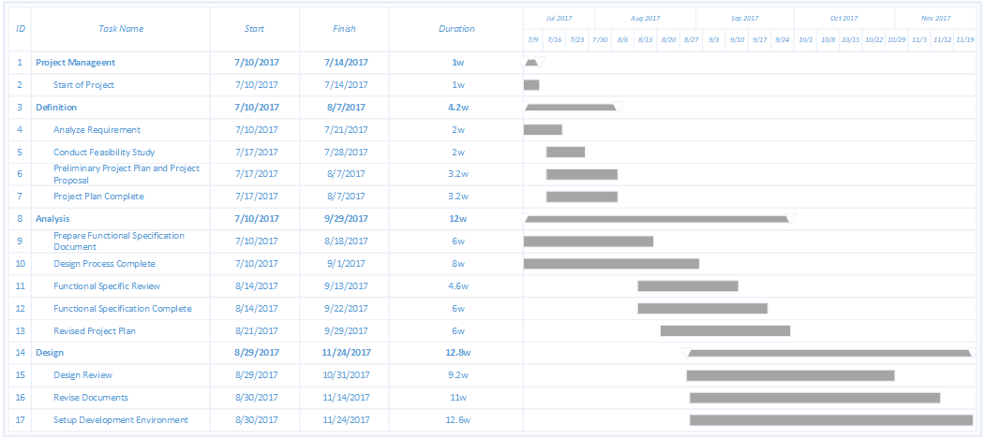
Gantt Chart

Slide 16
Work Breakdown Structure
Requirement Gathering
Planning
Designing
Implementation
Testing
Feasibility Study
Planning Documentation Approval
GUI Design
Database Design
Design Approval
Create Client- Account Functionality
Feedback form Functionality
System Testing
Alpha Testing
Beta Testing
Defining Scope and Objective
Cost Estimation
Human resource software hardware estimation
Add client account functionality
Deployment
Questionnaire
Software Requirements Specifications
Let's Meet

Slide 17
UML Diagram

Slide 18
List of Figures
Use Case
Class Diagram
Activity Diagram
Sequence Diagram
Deployment Diagram

Slide 19
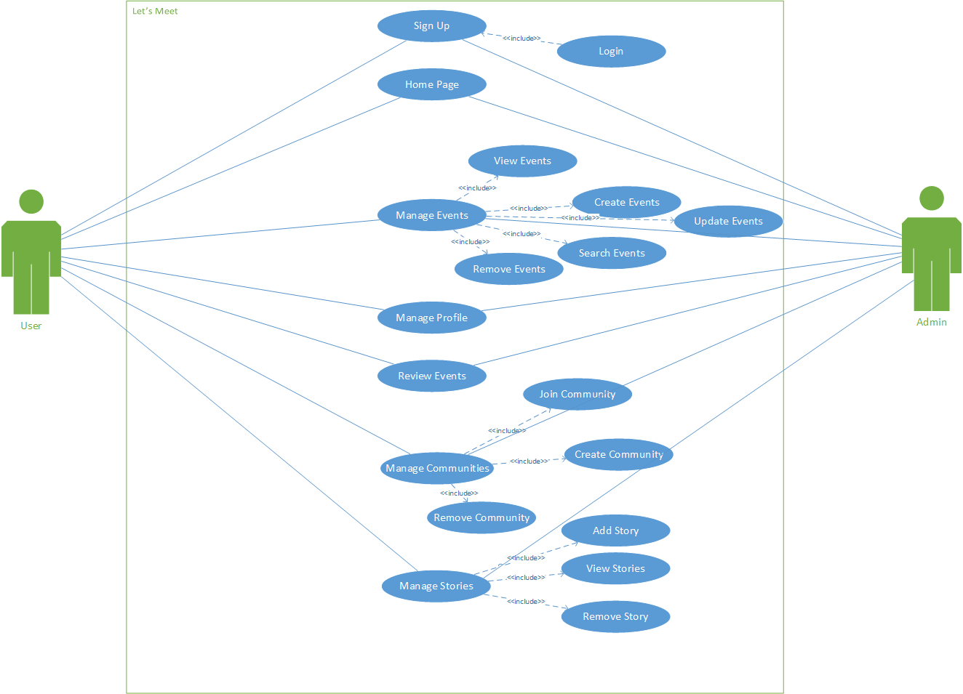
Use Case

Slide 20
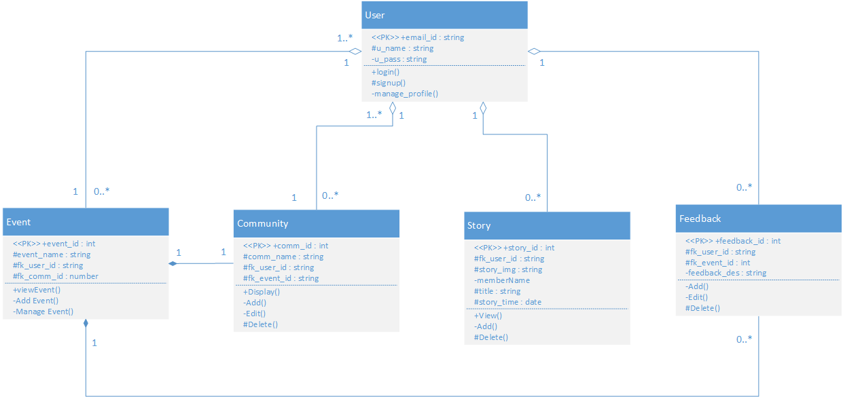
Class Diagram

Slide 21
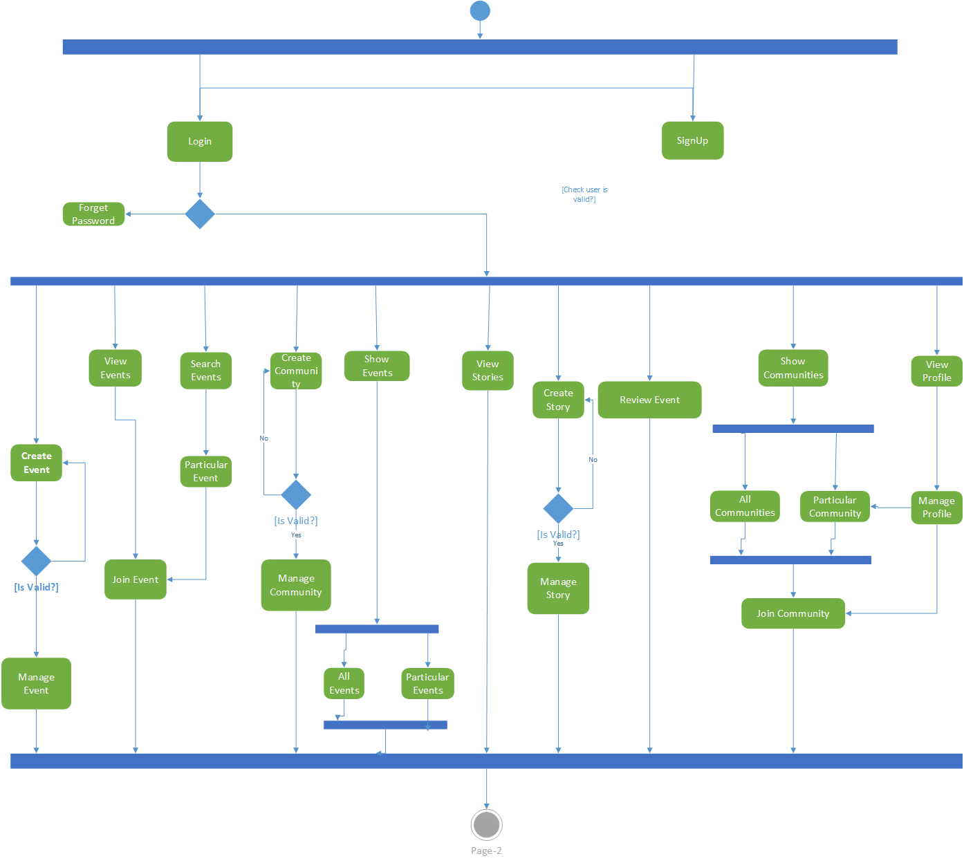
Activity Diagram (User)

Slide 22
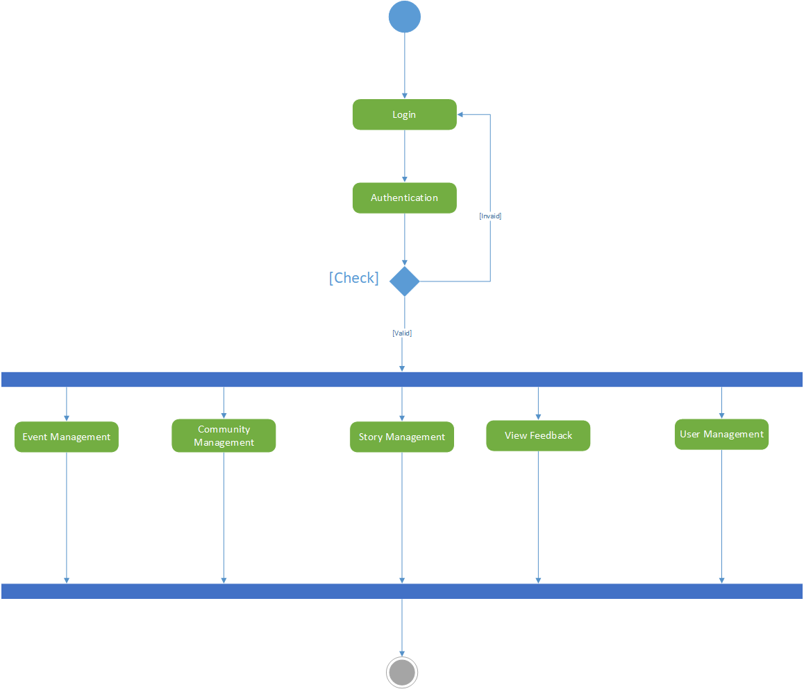
Activity Diagram (Admin)

Slide 23
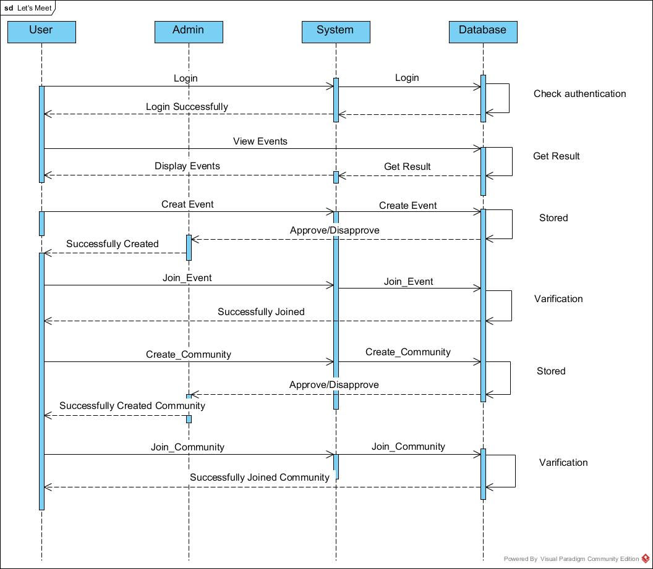
Sequence Diagram - I

Slide 24
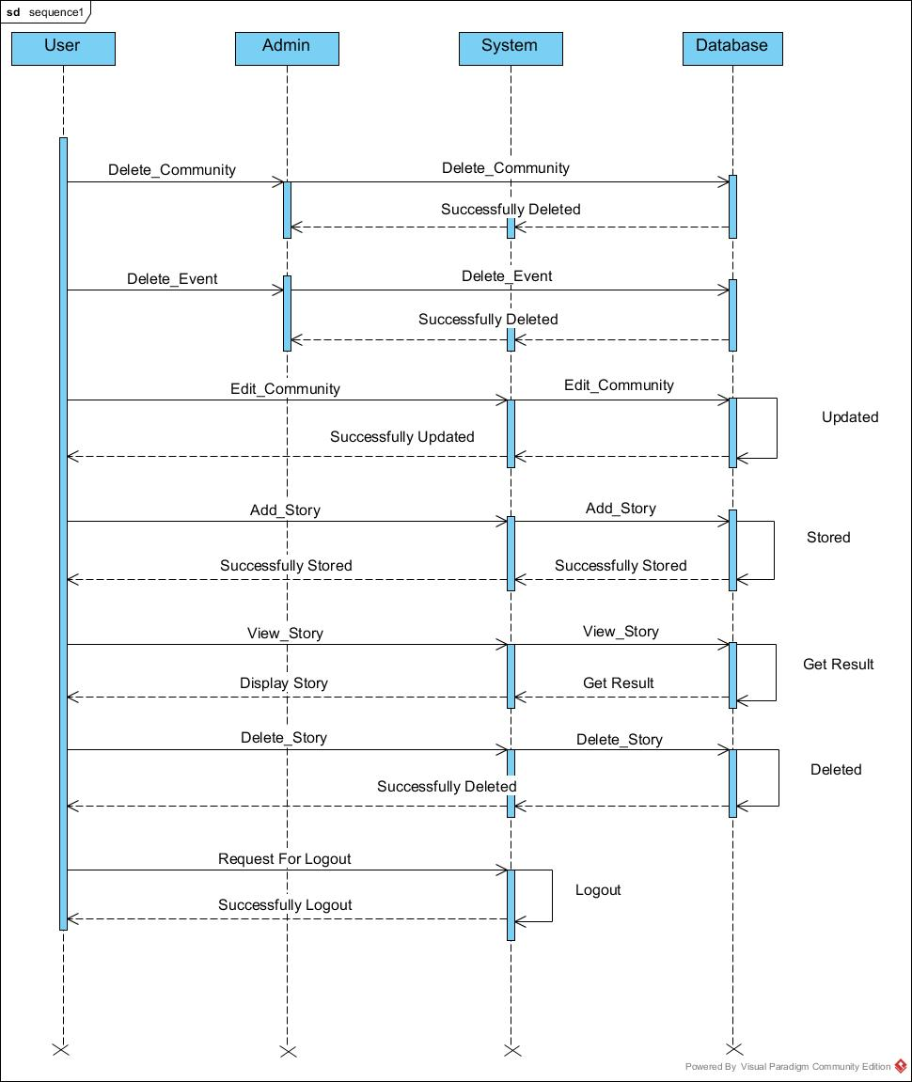
Sequence Diagram - II

Slide 25
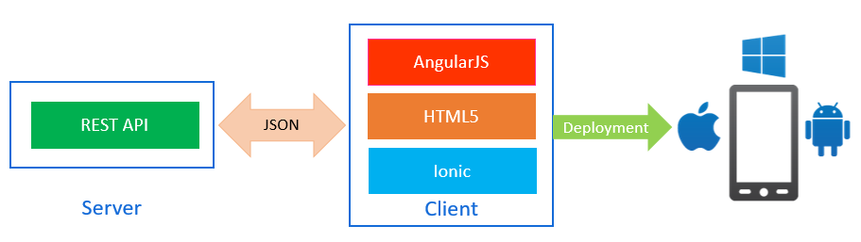
Deployment Diagram

Slide 26
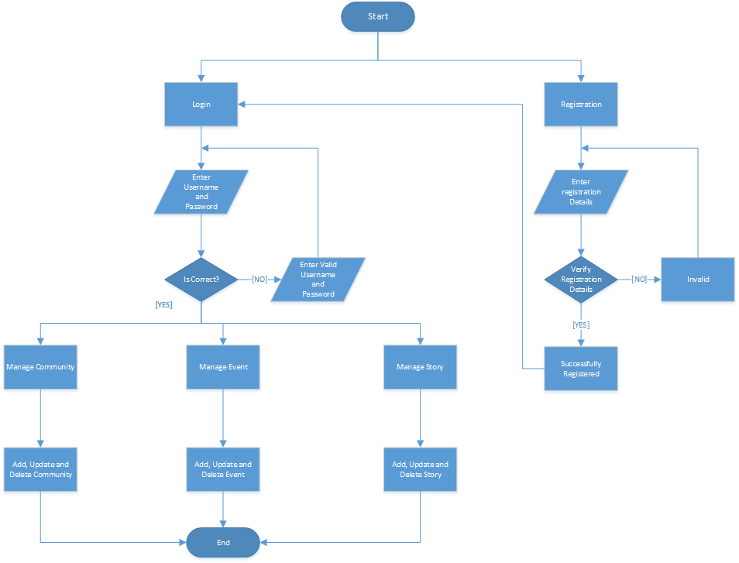
System Flow Diagram

Slide 27
Data Dictionary

Slide 28
List of Tables
Users
Communities
Events
Story
Community Members
Feedbacks
Posts
Likes
Comments
RSVP
Follower
Categories

Slide 29
Users
Comunities
Field | Data-Type | Constrains | Remarks | Description
User_id | Varchar(30) | Primary Key | - | User’s email id.
User_name | Varchar(20) | Not Null | - | Display User’s Name
User_photo | Varchar(500) | - | - | Display Picture
Gender | Boolean | - | - | User’s Gender
Password | Varchar(10) | Not Null | - | Password for Login
Mobile_no | Varchar(15) | - |  | User’s Mobile No
Birth_date | Date | - | - | User’s Birth Date
Field | Data-Type | Constrains | Remarks | Description
Comm_id | Integer | Primary Key | Auto-Increment | Community id
Comm_name | Varchar(20) | Not Null | - | Community Name
Comm_des | Varchar(300) | Not Null | - | Describe the community
Comm_photo | Varchar(500) | - | - | Community Picture
Date | Date | Not Null | - | Date created
Created_by | Varchar(50) | Foreign Key | - | Users created Community
Comm_rating | Integer |  | - | Rating of Community

Slide 30
Events
Story
Field | Data-Type | Constrains | Remarks | Description
Event_id | Integer | Primary Key | Auto-Increment | Event’s Id
Event_name | Varchar(100) | Not Null | - | Event’s Name
Event_pic | Varchar(500) | - | - | Event Photo
Event_des | Varchar(500) | - | - | Event Description
Event_time | Varchar(20) | - | - | Event Time
Event_date | Date | Not Null | - | Event Date
Event_loc | Varchar(100) |  | - | Event Venue
Fk_user_id | Varchar(30) | Foreign Key | - | Who Created?
Fk_comm_id | Integer | Foreign Key | - | Under Which Community?
Field | Data-Type | Constrains | Remarks | Description
Story_id | Integer | Primary Key | Auto-Increment | Story id
Story_pic | Varchar(500) | Not Null | - | Story Photo
Fk_user_id | Varchar(30) | Foreign Key | - | Who Posted?
Story_title | Varchar(100) | Not Null | - | Story Caption
Story_time | Date | Not Null | - | When Story Posted?

Slide 31
Community Members
Feedbacks
Field | Data-Type | Constrains | Remarks | Description
Join_id | Integer | Primary Key | Auto-Increment | Community join Id
Fk_user_id | Varchar(30) | Foreign Key | - | User who joined community
Fk_comm_id | Integer | Foreign Key | - | Which community did user joined
Field | Data-Type | Constrains | Remarks | Description
Feed_id | Integer | Primary Key | Auto-Increment | Feedback id
Fk_event_id | Integer | Foreign Key | - | Under which Event
Fk_user_id | Varchar(30) | Foreign Key | - | Who gave feedback?
Feed_desc | Varchar(200) | Not Null | - | Feedback Description.

Slide 32
Posts
Likes
Field | Data-Type | Constrains | Remarks | Description
Post_id | Integer | Primary Key | Auto-Increment | Post Id
Post_title | Varchar(30) | Not Null | - | Caption
Post_des | Varchar(200) | - | - | Describe the Post
Post_pic | Varchar(500) | - | - | Photo in Post
Fk_user_id | Varchar(30) | Foreign Key | - | User who posted this Post
Fk_comm_id | Integer | Foreign Key | - | Under which Community
Date | Date | Not Null | - | Date Created Post.
Field | Data-Type | Constrains | Remarks | Description
Like_id | Integer | Primary Key | Auto-Increment | Like id
Fk_post_id | Integer | Foreign Key | - | Under which Post
Fk_user_id | Varchar(30) | Foreign Key | - | Who liked?

Slide 33
Comments
RSVP
Field | Data-Type | Constrains | Remarks | Description
Com_Id | Integer | Primary Key | Auto-Increment | Comment id
Fk_post_id | Integer | Foreign Key | - | Under which post
Fk_user_id | Varchar(30) | Foreign Key | - | Who commented?
Date | Date | Not Null | - | Date Created
Com_des | Varchar(300) | Not Null | - | Content of Comment
Field | Data-Type | Constrains | Remarks | Description
Rsvp_id | Integer | Primary Key | Auto-Increment | RSVP id
Fk_user_id | Varchar(30) | Foreign Key | - | Users attending event
Fk_event_id | Varchar(50) | Foreign Key | - | Which event user is going to attend?

Slide 34
Polls
Field | Data-Type | Constrains | Remarks | Description
Poll_id | Integer | Primary Key | Auto-Increment | Poll Id
Poll_title | Varchar(100) | Not Null | - | Tag line of Poll
Option1 | Varchar(50) | Not Null | - | First opinion of poll
Option2 | Varchar(50) | Not Null | - | Second opinion of Poll
Option3 | Varchar(50) | - | - | Third opinion of Poll
Option4 | Varchar(50) | - | - | Fourth opinion of Poll
Fk_user_id | Varchar(30) | Not Null | - | Who Created?
Fk_comm_id | Integer | Not Null | - | Under Which Community?

Slide 35
Follower
Categories
Field | Data-Type | Constrains | Remarks | Description
Follo_id | Integer | Primary Key | Auto-Increment | Follower Id
Fk_user_id | Varchar(30) | Foreign Key | - | User being followed
Fk_us_id | Varchar(30) | Foreign Key | - | Who Followed?
Field | Data-Type | Constrains | Remarks | Description
Cat_id | Integer | Primary Key | Auto-Increment | Category Id
Cat_name | Varchar(20) | Not Null | - | Category Name

Slide 36
User Interface

Slide 37
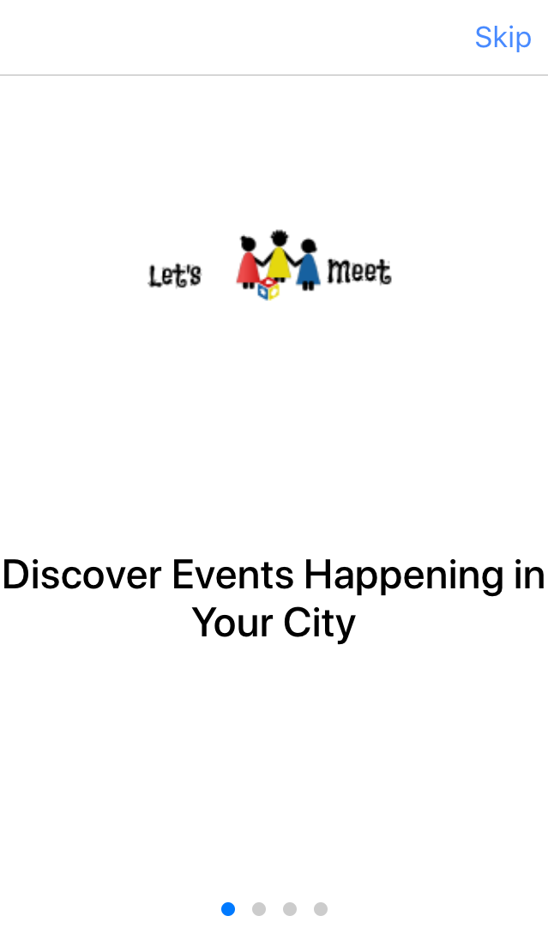
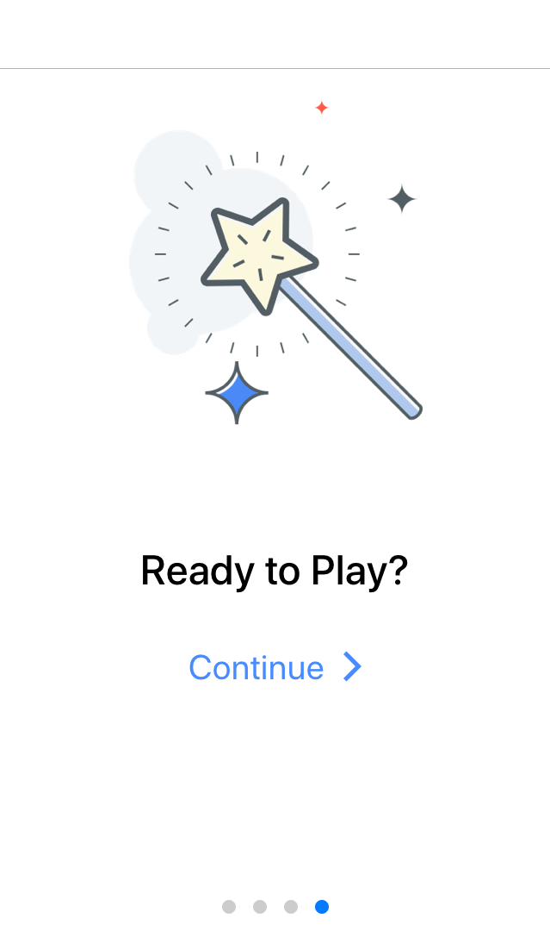
Tutorial

Slide 38
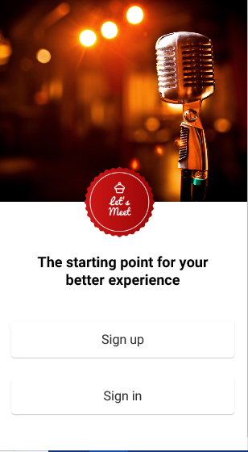
Start-up

Slide 39
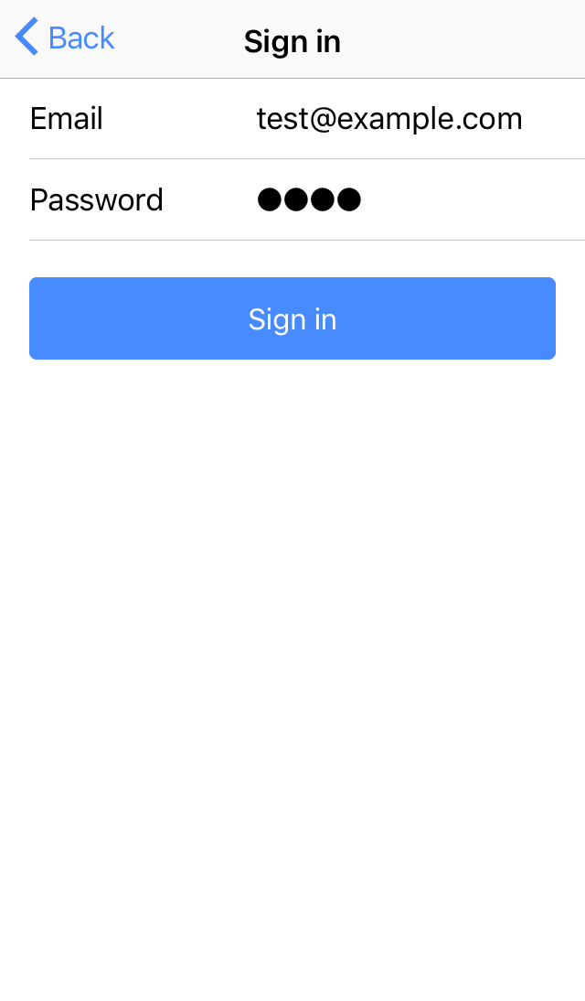
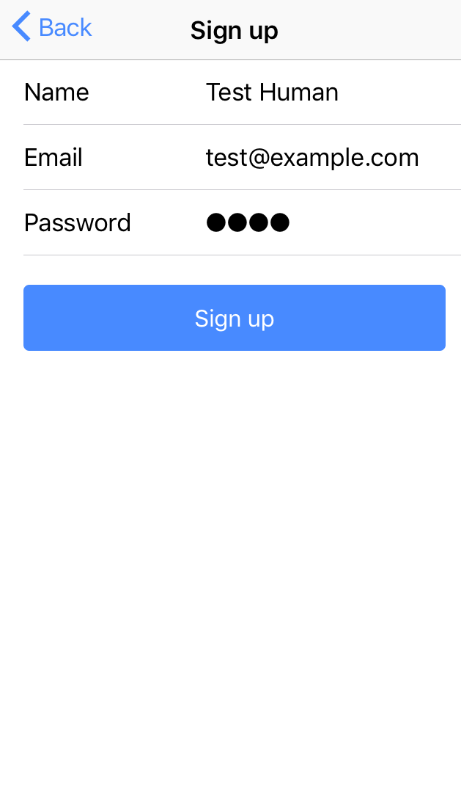
Login / Sign Up
Login
Sign Up

Slide 40
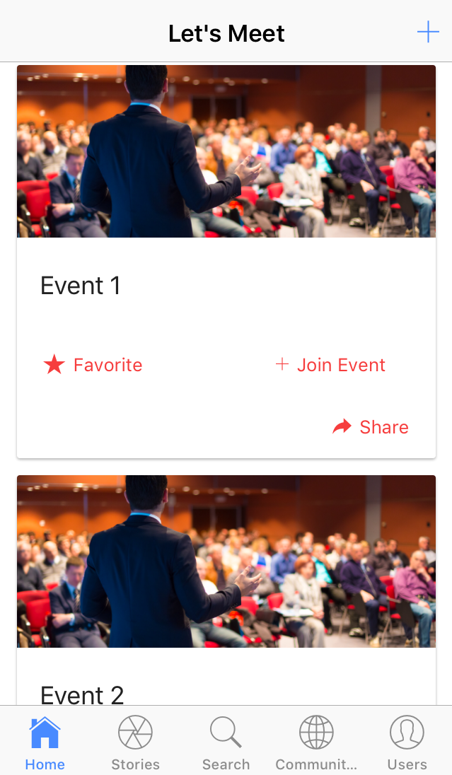
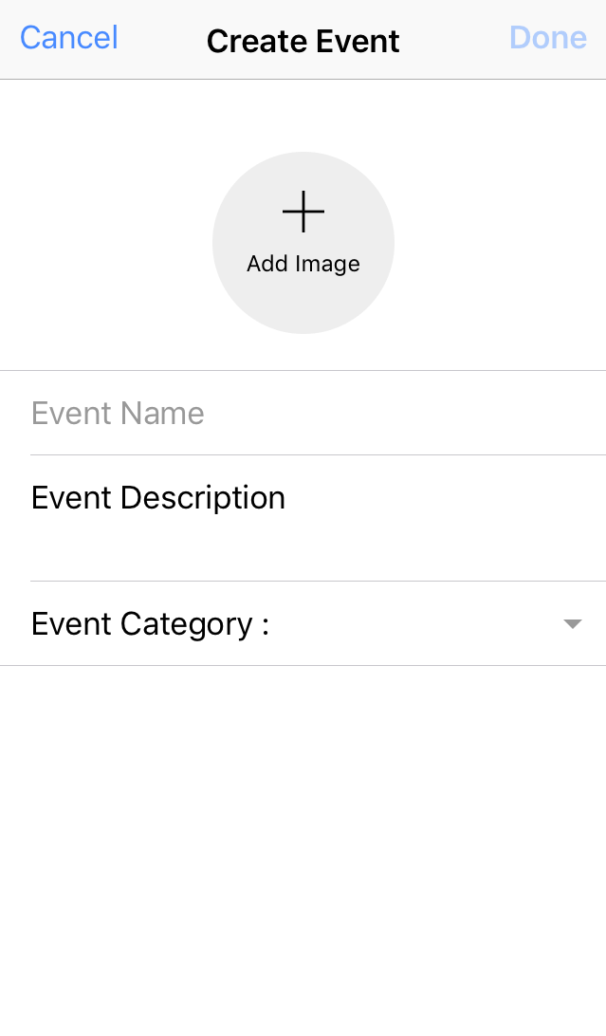
Events Tab
View Events
Create Event

Slide 41
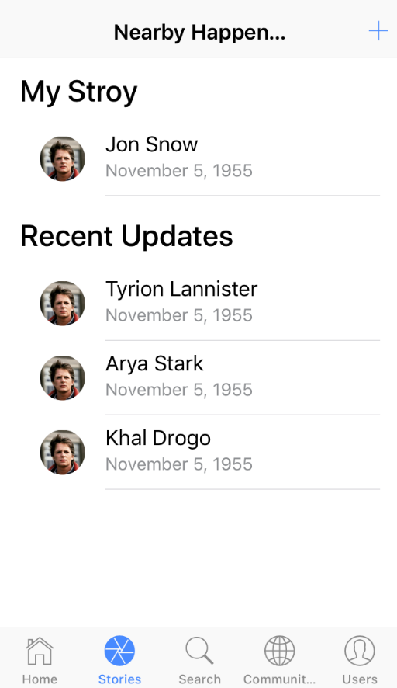
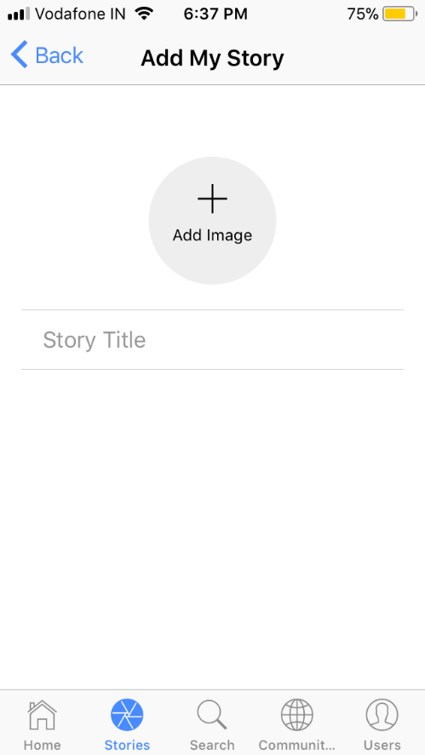
Stories Tab
View Stories
Add Story

Slide 42
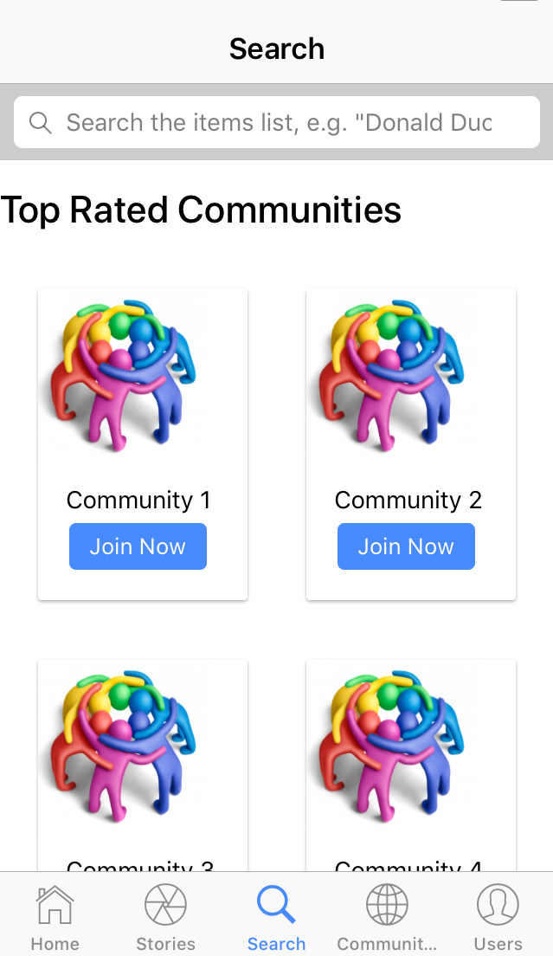
Search Tab

Slide 43
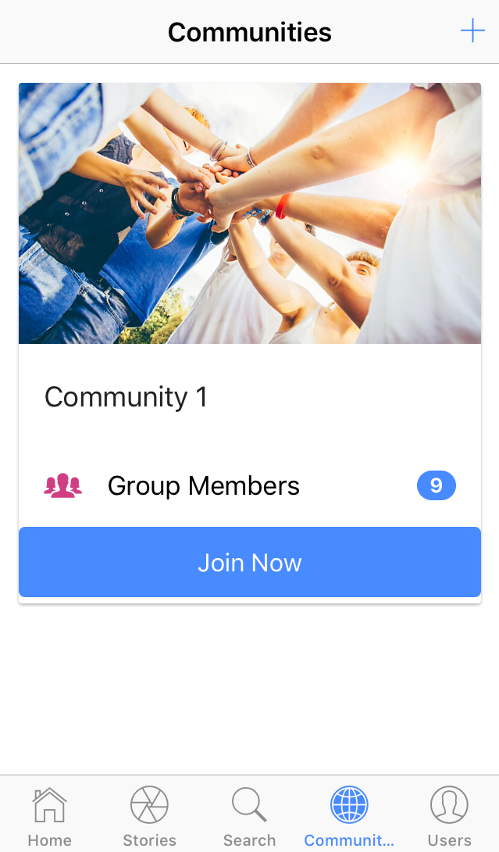
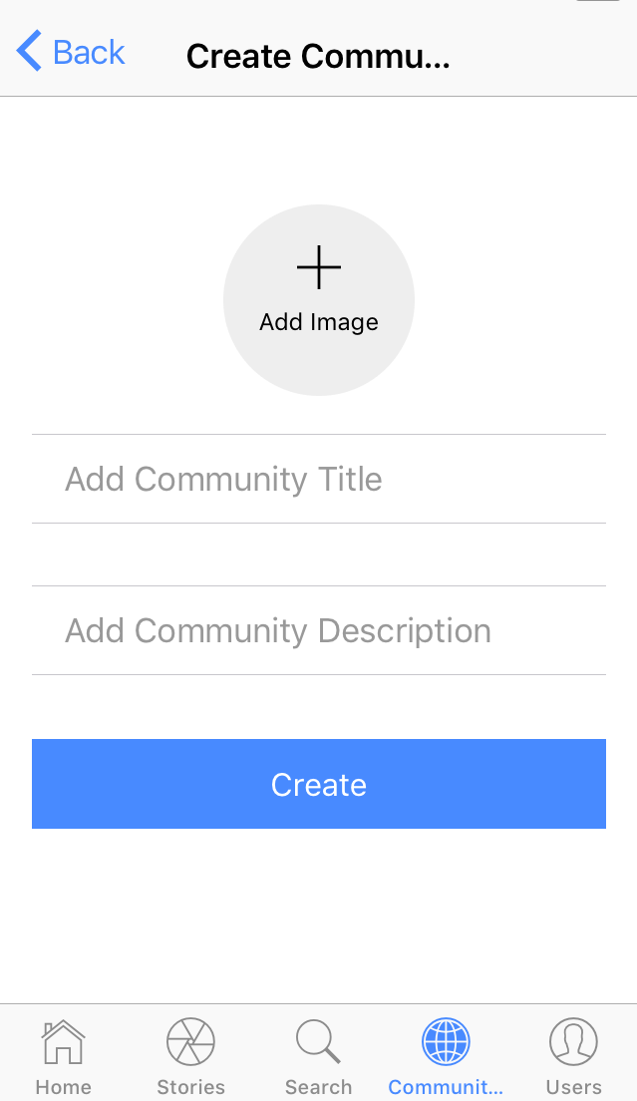
Communities Tab
View Communities
Create Community

Slide 44
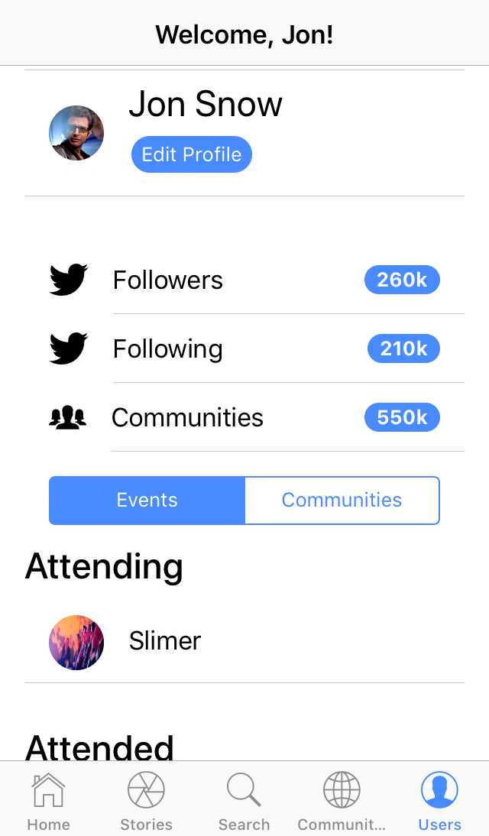
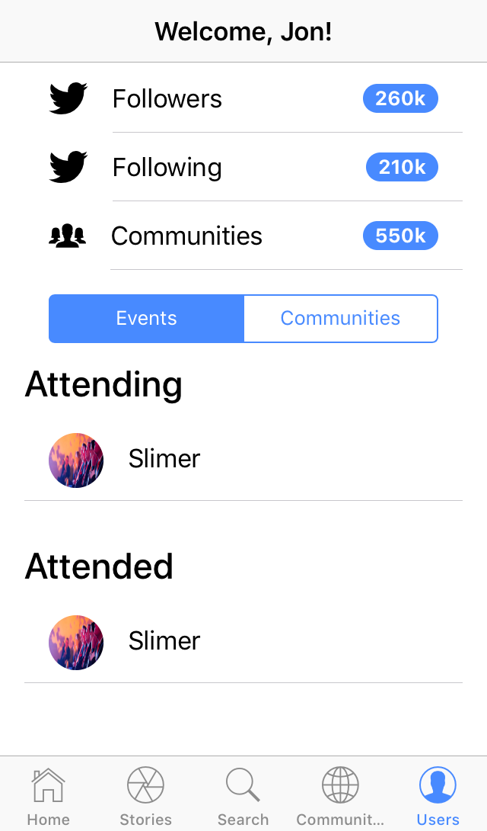
User Profile Tab (Events)

Slide 45
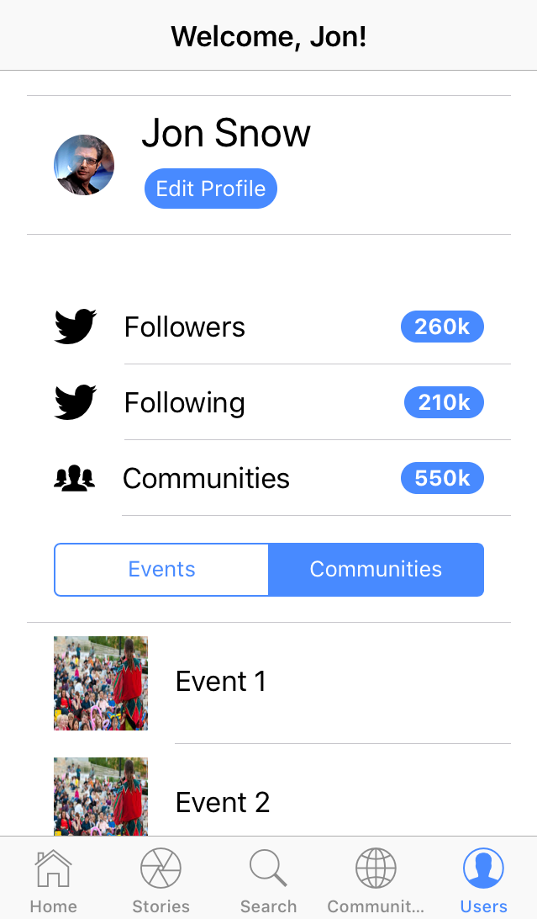
User Profile Tab (Communities)

Slide 46
System Navigation
Home Page
Events
Stories
Search
Communities
Profile
View Events
Create Events
Join Events
View Stories
Add Stories
Search by Category
View Upcoming Events
View Communities
Create Communities
Join Communities
Edit Profile
View Profile
Change Password

Slide 47
Limitations
If user upload/share his very important document then there is no provision for security.
If the user might not able to deal with English language then user might not able to use the system efficiently.
User must be a member of any community to create event.

Slide 48
Future Scope
There are chances that system can cooperate with payment gateways to generate revenue.
There are chances that user can register in event directly through our system.
There are chances that users can directly communicate with each other and as well as with speakers through our system.

Slide 49
Bibliography
SOFTWARE ENGINEERING a practitioner’s Approach Seventh Edition by Roger S. Pressman
https://angular.io/
https://ionicframework.com/

